Slide 1
UNIVERSITY INSTITUTE OF ENGINEERING
COMPUTER SCIENCE ENGINEERING
Master of Engineering
ADVANCED DATA STRUCTURES
&
ALGORITHMS
(23CSH-622)
INTRODUCTION
DISCOVER . LEARN . EMPOWER

Slide 2

ADVANCED DATA STRUCTURES
&
ALGORITHMS
(23CSH-622)
By : Dr. Ranjit Singh (E10947)
www. cuchd.in Campus : Gharaun, Mohali

Slide 3
Contents of the Syllabus
UNIT-I (15h)
Introduction to Basic Data Structures: Importance and need of good data structures and algorithms, Introduction to linear and non-linear data structure and its importance, Algorithms Complexity and Analysis. [3]
Linear and Non –Linear Data Structures : Arrays , Link Lists, Queues , Trees and related algorithms [6]
Advanced Data Structures: AVL Trees (Insertion , Deletion , Searching), Red-Black Trees, B-trees, B+trees, Heaps. Data structure for disjoint sets, Augmented data structures. [6]
UNIT-II (15h)
Searching and Sorting : Internal and External Sorting algorithms: Linear Search, Binary Search, Bubble Sort, Selection Sort, Insertion Sort, Shell Sort, Quick Sort, Heap Sort, Merge Sort, Counting Sort, Radix Sort and analysis of their complexities and Hashing [4]
Graphs & Algorithms: Representation, Type of Graphs, Depth- and breadth-first traversals, Planar graphs, isomorphism, graph coloring, covering and partition, Minimum Spanning Tree: Prim’s and Kruskal’s algorithms. [6]
String Matching Algorithms: Naïve String Matching, Suffix arrays, Suffix trees, Rabin-Karp, Knuth-Morris-Pratt, Booyer-Moore algorithm [5]

Slide 4
Contents of the Syllabus
UNIT-III (15h)
Approximation algorithms: Need of approximation algorithms: Introduction to P, NP, NP-Hard and NP-Complete Greedy Approach, Dynamic Approach, Knapsack, Huffman Coding, TSP, All pair shortest path, Longest Common Subsequence Problem, Matrix Chain Multiplication. [7]
Randomized algorithms: Introduction, type of randomized algorithms, Quick sort, min cut [4]
Online Algorithms: Introduction, Online Paging Problem, k-server Problem. Data compression: Huffman’s coding, BWT, LZW [4]
Recommended Books:
1. Cormen, Leiserson, Rivest, Stein, “Introduction to Algorithms”, Prentice Hall of India, 3rd edition 2012.
2. Horowitz, Sahni and Rajasekaran, “Fundamental of Computer, Algorithms”, University Press (India), 2nd edition.
3. Aho, Haperoft and Ullman, “The Design and analysis of Computer Algorithms”, Pearson Education India.

Slide 5
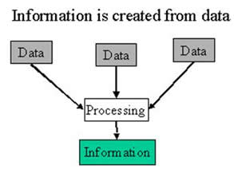
Data & Information
Data - Data usually refers to raw data, or unprocessed data. It is the basic form of data, data that hasn’t been analyzed or processed in any manner. Eg: 123, Ajay
Information - Once the data is analyzed, it is considered as information.
Eg: Roll no:123, Name=“Ajay”

Slide 6
Data Type and Data Structure
Data type
Set of possible values for variables
Operations on those values
Ex : int, float, char ……….
Data Structure
A data structure is an arrangement of data in a computer's memory or even disk storage.
The logical and mathematical model of a particular organization of data is called a data structure.
A data structure is a particular way of storing and organizing data in a computer so that it can be used efficiently.

Slide 7
Data Structures
Arrays
Stacks
Queues
Trees
Graphs

Slide 8
Linear and Non-Linear Data structures
Linear data structure: A data structure is said to be linear if the elements form a sequence, for example Array, Linked list, stack ,queue etc.
Non-Linear data structure: Elements in a nonlinear data structure do not form a sequence, for example Tree, graph.

Slide 9
Operations on Data Structure
Traversing: Accessing each records exactly once so that certain items in the record may be processed.
Searching: Finding the location of a particular record with a given key value, or finding the location of all records which satisfy one or more conditions.
Inserting: Adding a new record to the structure.
Deleting: Removing the record from the structure.
Sorting: Managing the data or record in some logical order(Ascending or descending order).
Merging: Combining the record in two different sorted files into a single sorted file.

Slide 10
Basic of C and C++
C | C++
It is a robust language. | CLASS (Data Members and Member Functions)
It is a low programming level language close to machine language. | OBJECTS
It is widely used in the software development field. | ENCAPSULATION
It is a procedure and structure oriented language. | POLYMORPHISM (Operator Overloading and Function Overloading)
If you know ‘C,’ you can easily grasp the knowledge of the other programming languages that uses the concept of ‘C’ | INHERITANCE (Types of Inheritance)
It is essential to have a background in computer memory mechanisms because it is an important aspect when dealing with the C programming language. | ABSTRACTION

Slide 11
FUNCTION & RECURSION
A Function is a block of code which only runs when it is called. You can pass data, known as parameters, into a function. Functions are used to perform certain actions, and they are important for reusing code: Define the code once, and use it many times.
Recursion is the process where a function calls itself as its subroutine in order to solve a complex iterative task by dividing it into sub-tasks. Any function which calls itself recursively is called recursive function, and the process of calling a function by itself is known as recursion.
Recursion leads to several number of iterative calls, however, it is necessary to have a base case to stop recursion otherwise it will lead to an infinite call. Example:

Slide 12
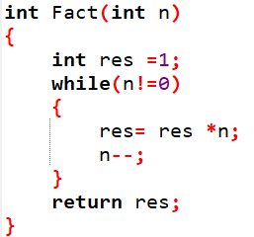
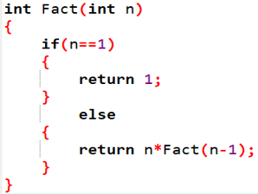
ITERATION V/S RECURSION
A recursive implementation and an iterative implementation do the same exact job, but the way they do the job is different.
Recursion involves a function that calls itself. Iteration uses a counter to track through a structure or complete an operation n times.
Iterative Function
Recursive Function

Slide 13
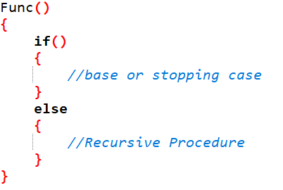
RECURSIVE FUNCTION EXAMPLE
In if block, we mention the base case which is the stopping point to stop the recursive process.
In else block, we mention the recursive procedure in which the problem is divided into smaller problems.
IDEA BEHIND RECURSION- To solve a problem, solve a sub-problem that is a smaller instance of the same problem, and then use the solution to that smaller instance to solve the original problem
For example here, we can start from the easiest one i.e. factorial(1)
Fact(1) = 1
Fact(2) = 2 * 1 = 2 * Fact(1)
Fact(3) = 3 * 2 * 1 = 3 * Fact(2)
Fact(4) = 4 * 3 * 2 * 1 = 4 * Fact(3)

Slide 14
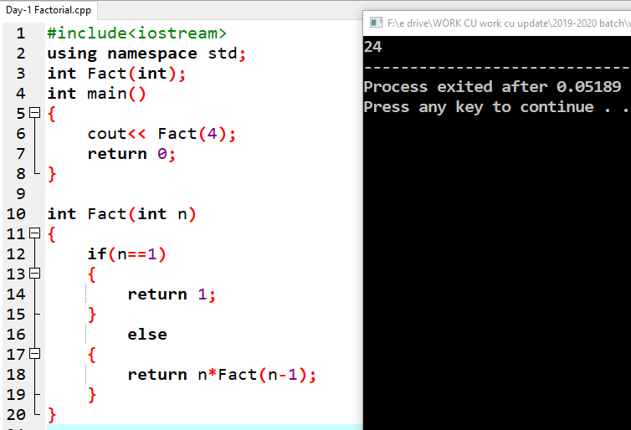
PROGRAM TO CALCULATE FACTORIAL USING RECURSION

Slide 15
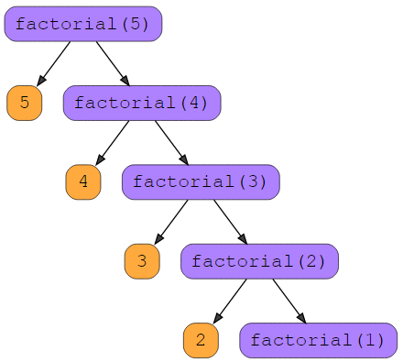
TRACING TREE OF RECURSIVE FUNCTION
There are two parts to this function:
Multiplication of the target with the returned value
With the returned value of the child function
We cannot multiply until we have the returned value
of the child function. That’s why, we move to child
function next.

Slide 16
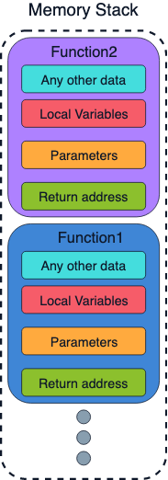
MEMORY ALLOCATION IN RECURSION
When a function is called, its memory is allocated on a stack.
Stacks in computing architectures are the regions of memory where data is added or removed in a last-in-first-out (LIFO) process.
Each program has a reserved region of memory referred to as its stack.
When a function executes, it adds its state data to the top of the stack. When the function exits, this data is removed from the stack.

Slide 17
ADVANTAGES OF RECURSION
Which path should I follow?
Iteration or recursion? For this, let’s look at the advantages of recursive function:
Every recursive program can be modelled into an iterative program but recursive programs are more elegant and required less lines of code.
Recursive solutions often tend to be shorter and simpler than non-recursive ones.
Code is clearer and easier to use.
Recursion represents like the original formula to solve a problem.
Follows a divide and conquer technique to solve problems.
In some (limited) instances, recursion may be more efficient.

Slide 18
DISADVANTAGES OF RECURSION
Recursion is implemented using system stack. If the stack space on the system is limited, recursion to a deeper level will be difficult to implement.
Recursion utilize more function calls.
Using a recursive function takes more memory and time to execute as compared to its non-recursive counter part.
It is difficult to find bugs, particularly, when using global variables.
Although recursion is not recommended for all problems but is best suited for problems such as sorting, searching, inorder/preorder/postorder tree traversals, DFS order of graph algorithms.

Slide 19
TYPES OF RECURSION
Direct Recursion
Direct recursion is when Method A calls itself again. It is of following types:
Tail Recursion
Head (Non- Tail) Recursion
Nested Recursion
Tree Recursion
Indirect Recursion
Indirect recursion is when Method A calls a different method, this in turn calls the original calling Method A. The primary difference is indirect recursion is making use of more than one method

Slide 20
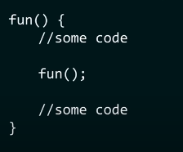
TYPES OF RECURSION- DIRECT
DIRECT RECURSION
A function is called direct recursive if it calls the same function again.
Structure of direct recursion

Slide 21
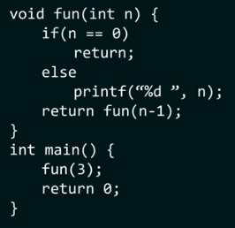
TAIL RECURSION
A function is said to be tail recursive if the recursive call is the last thing done by the function. There is no need to keep record of previous state. Tail recursion occurs, when the result of a recursive function call completely depends on the same function call, just with other parameters.
Last thing done by the function is recursion

Slide 22
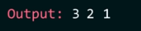
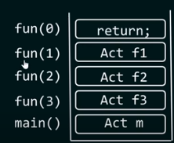
TAIL RECURSION
Returning
Back to
previous
Function and
nothing to
evaluate
F1 will get popped out of stack first, then f2,
then f3, and then main

Slide 23
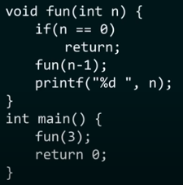
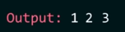
HEAD RECURSION
A function is said to be head recursive if the recursive call is the first thing done by the compiler. There’s no statement, no operation before the call. The function doesn’t have to process or perform any operation at the time of calling and all operations are done at returning time.
Recursion is not the last thing done by the
function but it has something to evaluate

Slide 24
TREE RECURSION
To understand Tree Recursion let’s first understand Linear Recursion.
If a recursive function calling itself for one time then it’s known as Linear Recursion.
Otherwise if a recursive function calling itself for more than one time then it’s known as Tree Recursion.
Tree recursive procedures typically take exponential time to compute.

Slide 25
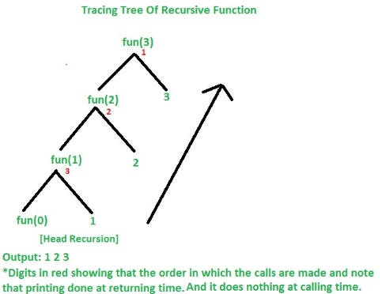
Let’s understand the example by
tracing tree of recursive function.
That is how the calls are made and how the outputs are produced.

Slide 26
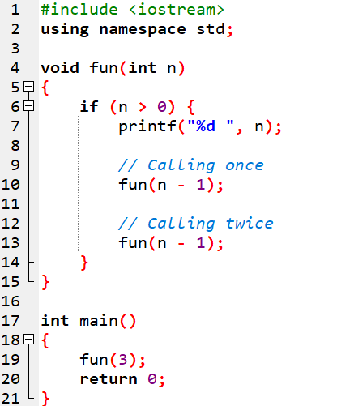
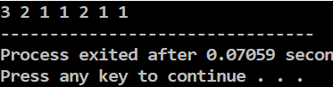
TREE RECURSION

Slide 27
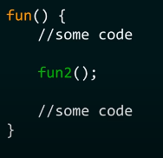
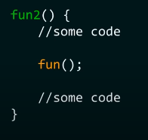
TYPES OF RECURSION- INDIRECT
INDIRECT RECURSION
A function (let’s say func) is called indirect recursive if it calls the another function (let’s say func2) and then that another function (func2) calls the first function (func).
Structure of indirect recursion

Slide 28
Contents
Introduction to Pointers
Dynamic Memory Allocation

Slide 29
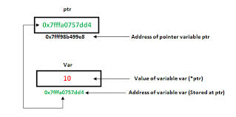
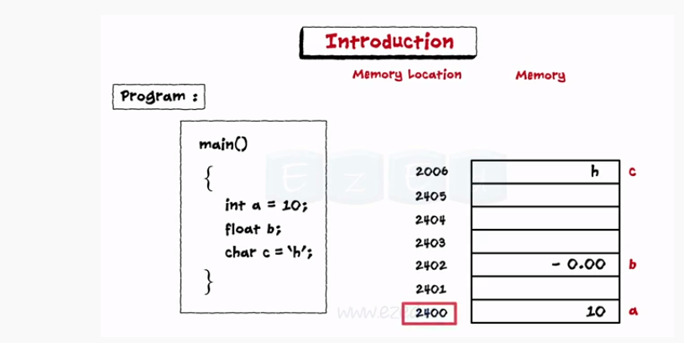
Pointers
A pointer is a variable whose value is an address, typed by its declaration. Pointers "point to" a variable (memory) with a typed value by referencing that variable, not by name, but by address.

Slide 30
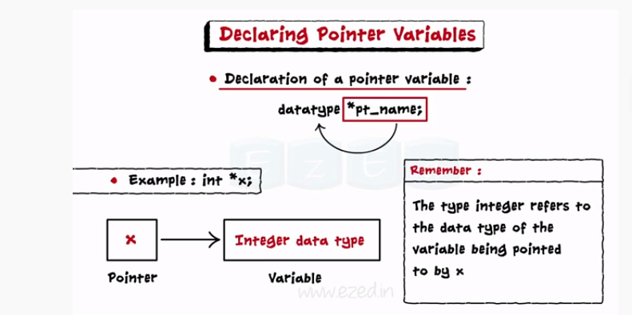
Declaring Pointer Variables

Slide 31
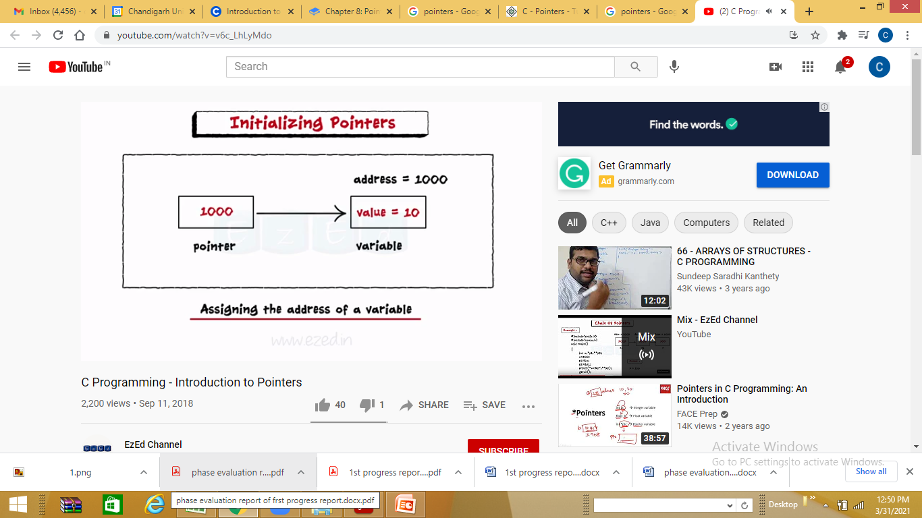
Initializing Pointers

Slide 32
Dynamic Memory Allocation
Programmers can dynamically allocate storage space while the program is running, but programmers cannot create new variable names "on the fly", and for this reason, dynamic allocation requires two criteria:
--Creating the dynamic space in memory
--Storing its address in a pointer (so that space can be accessed)
C++ defines two unary operators new and delete that perform the task of allocating and deallocating memory during runtime. Since these operators (new and delete) operate upon free store memory (Heap memory), they are also called free store operator, provide the necessary support for dynamic memory allocation system in C++.
Syntex datatype *pointer_name = new datatype
Example: int *ptr = new int;
.

Slide 33
Dynamic memory Allocation
Deallocation of memory using delete Keyword:
Once heap memory is allocated to a variable or class object using the new keyword, we can deallocate that memory space using the delete keyword.
delete pointer_variable;
Here, pointer_variable is the pointer that points to the data object created by new.

Slide 34
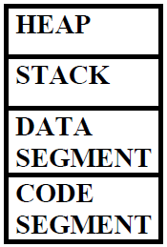
Pointers with memory management
Memory Allocation in C++
Heap: Memory is allocated during program execution. Memory is allocated using new operator and deallocating memory using delete operator. (Dynamic variables)
Stack: A stack is usually pre-allocated memory. The stack is a LIFO data structure. All local variables are stored in this memory (Static variables)
Data Segment: Global variables and static variables are kept in data segment.
Code Segment: Compiled program with executive instructions are kept in code segment. It is read only.

Slide 35
Memory Leak
Memory leak occurs when programmers create a memory in heap and
forget to delete it.
Memory leak occurs when all pointers to a block allocated memory have been lost.
Leaked memory cannot be reallocated or accessed.

Slide 36
Dynamic Memory Allocation in C
There are 4 library functions provided by C defined under <stdlib.h> header file to facilitate dynamic memory allocation in C programming. They are:
malloc()
calloc()
free()
realloc()

Slide 37
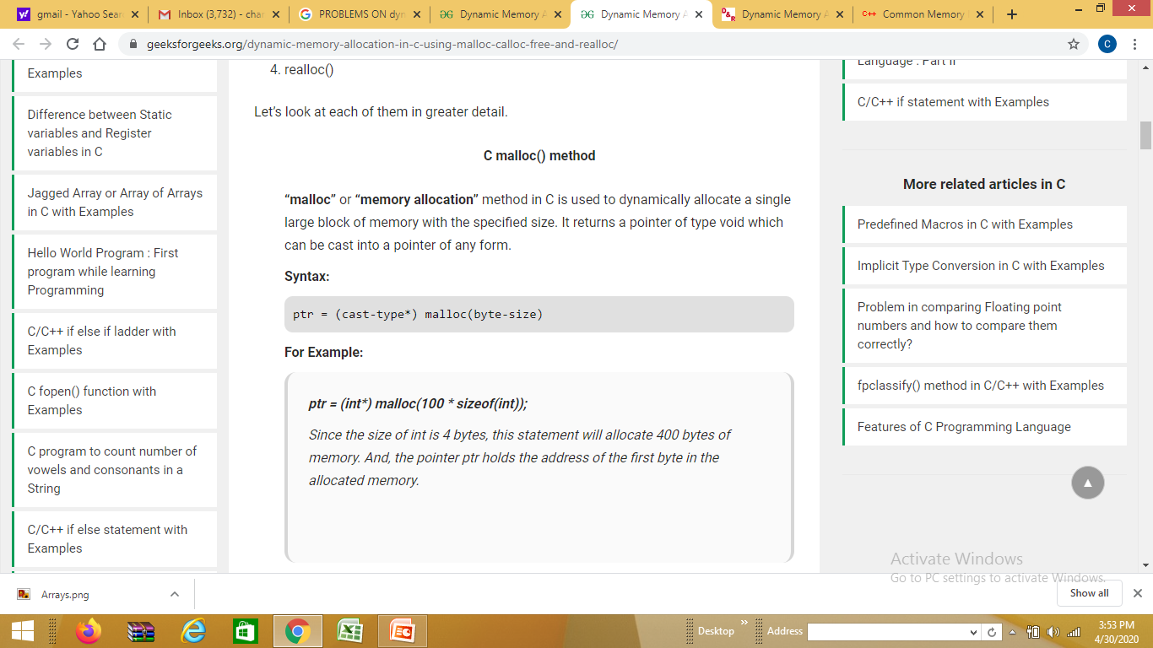
Malloc()
C malloc() method
“malloc” or “memory allocation” method in C is used to dynamically allocate a single large block of memory with the specified size. It returns a pointer of type void which can be cast into a pointer of any form
void* malloc (size_t size);

Slide 38
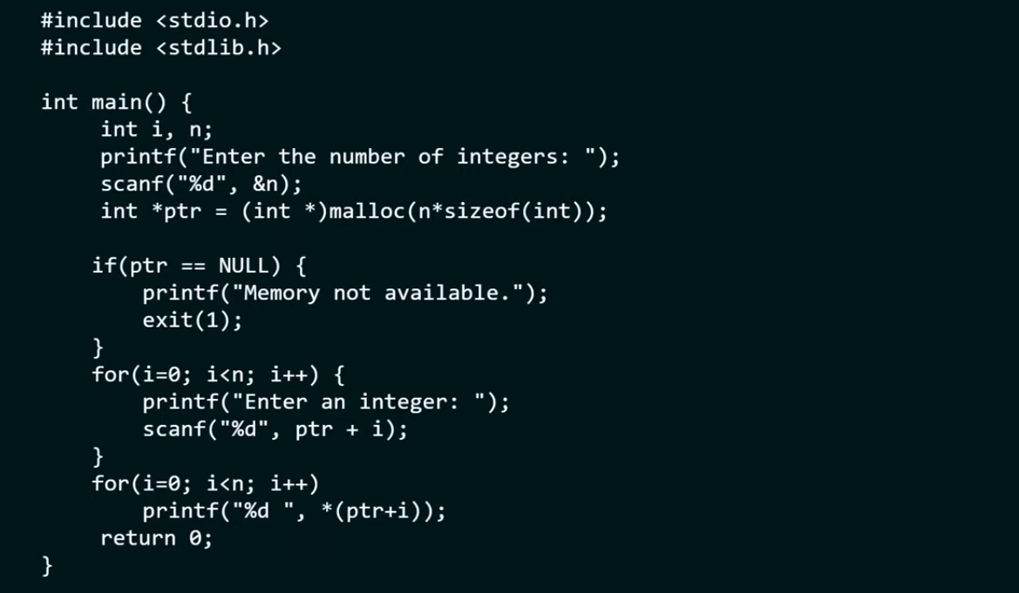
malloc

Slide 39
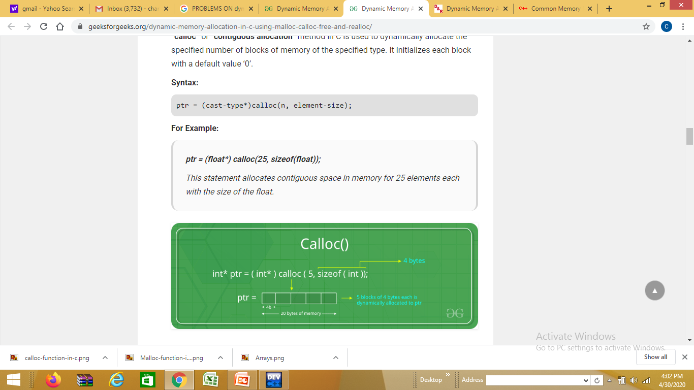
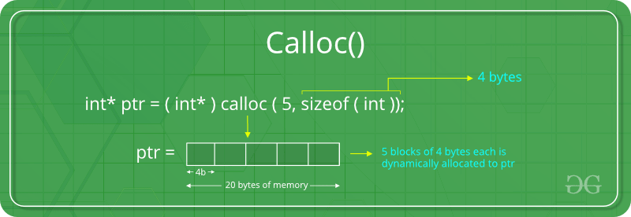
Calloc()
C calloc() method
“calloc” or “contiguous allocation” method in C is used to dynamically allocate the specified number of blocks of memory of the specified type. It initializes each block with a default value ‘0’.
Notes:
The key difference between calloc and malloc is that calloc allocates the memory and also initialize the allocated memory blocks to zero whereas malloc allocates the memory but does not initialize that allocated memory to zero. Accessing the content in calloc will give zero, but malloc will give a garbage value.

Slide 40
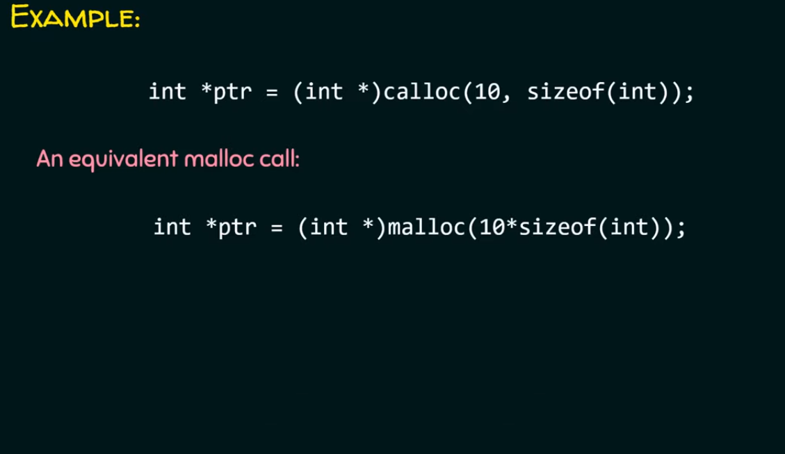
calloc

Slide 41
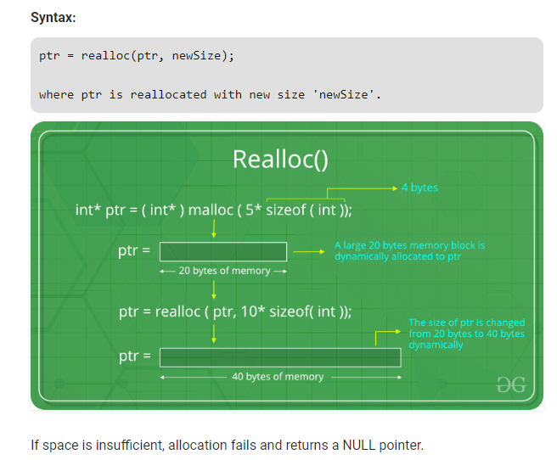
Realloc()
C realloc() method
“realloc” or “re-allocation” method in C is used to dynamically change the memory allocation of a previously allocated memory. In other words, if the memory previously allocated with the help of malloc or calloc is insufficient, realloc can be used to dynamically re-allocate memory.

Slide 42
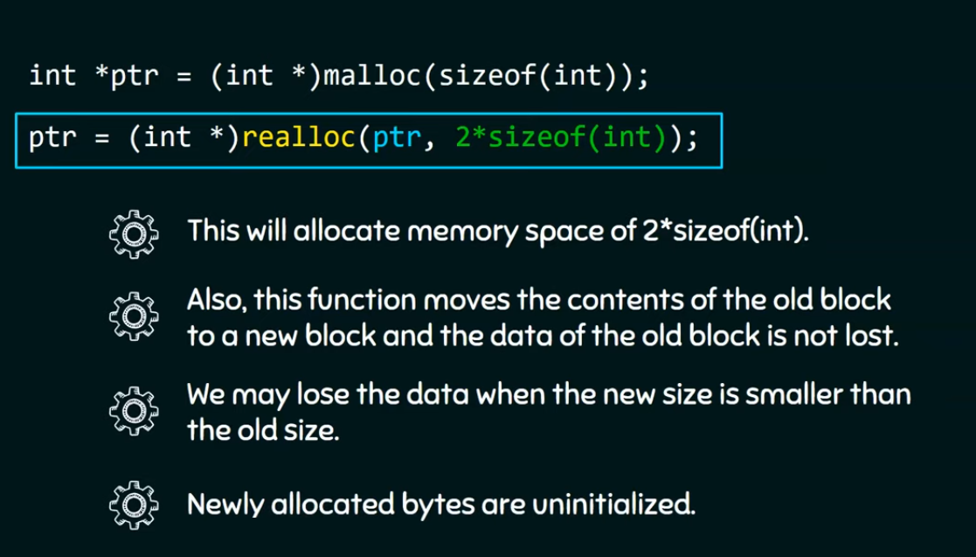
realloc

Slide 43
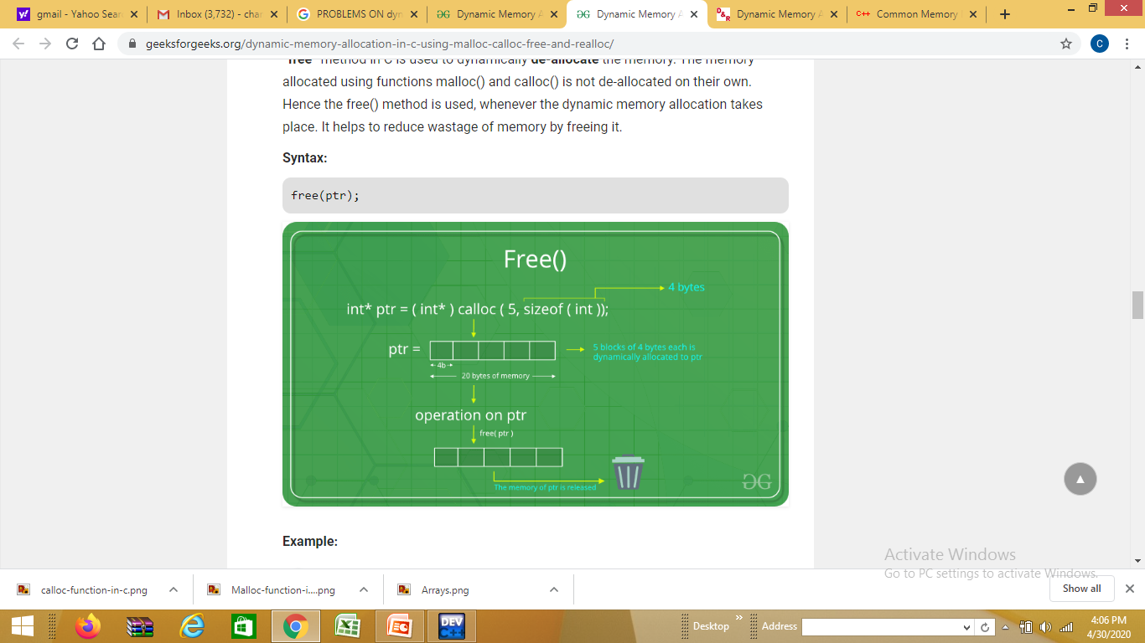
Free()
C free() method
“free” method in C is used to dynamically de-allocate the memory. The memory allocated using functions malloc() and calloc() is not de-allocated on their own. Hence the free() method is used, whenever the dynamic memory allocation takes place. It helps to reduce wastage of memory by freeing it.

Slide 44
Difference
malloc() | calloc()
Malloc() function will create a single block of memory of size specified by the user. | Calloc() function can assign multiple blocks of memory for a variable.
Malloc function contains garbage value. | The memory block allocated by a calloc function is always initialized to zero.
Number of argument is 1. | Number of arguments are 2.
Calloc is slower than malloc. | Malloc is faster than calloc.
It is not secure as compare to calloc. | It is secure to use compared to malloc.
Time efficiency is higher than calloc(). | Time efficiency is lower than malloc().
Malloc() function returns only starting address and does not make it zero. | Before allocating the address, Calloc() function returns the starting address and make it zero.
It does not perform initialization of memory. | It performs memory initialization.

Slide 45
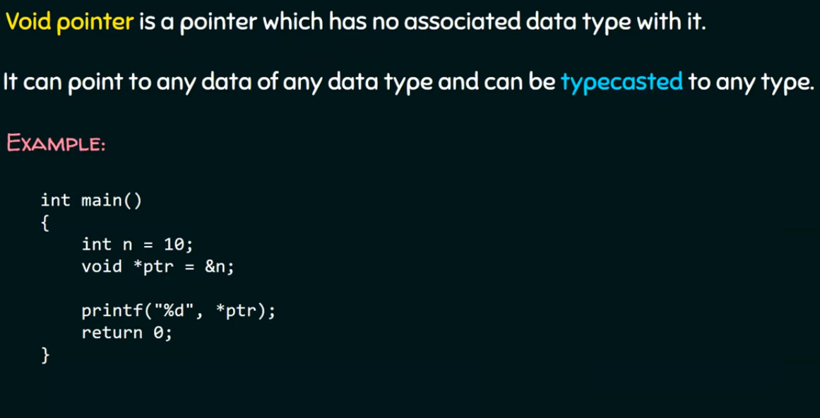
Void Pointer

Slide 46
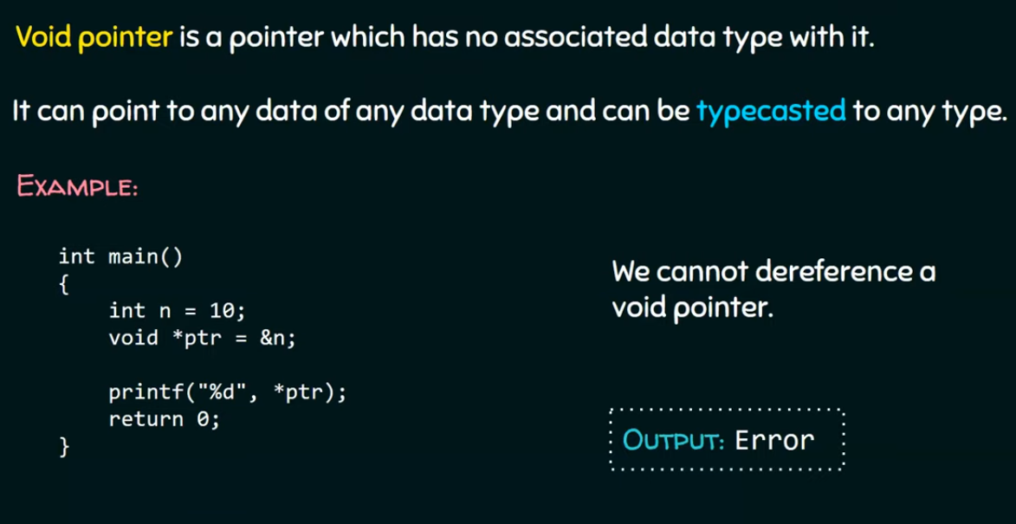
Void Pointer

Slide 47
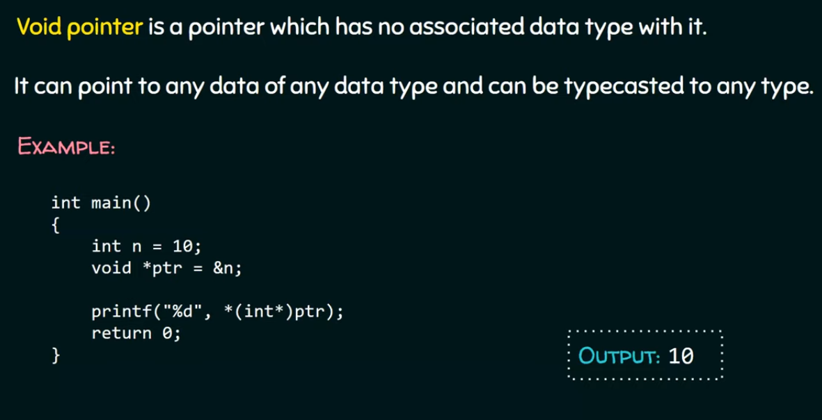
Void Pointer

Slide 48
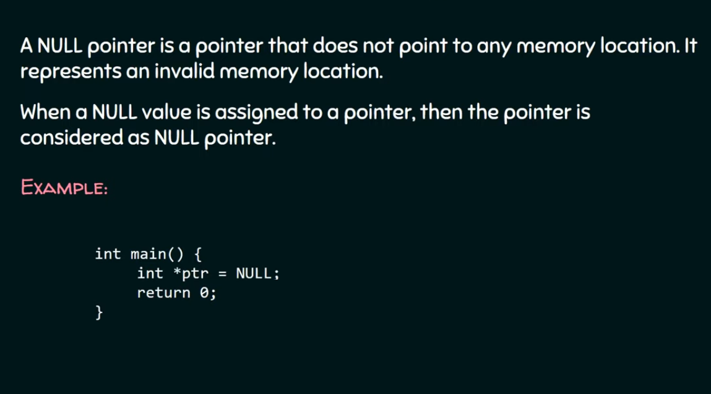
Null Pointer

Slide 49
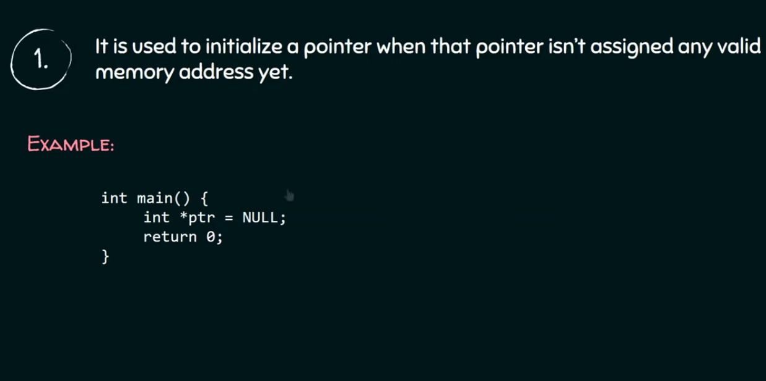
Use of Null Pointer

Slide 50
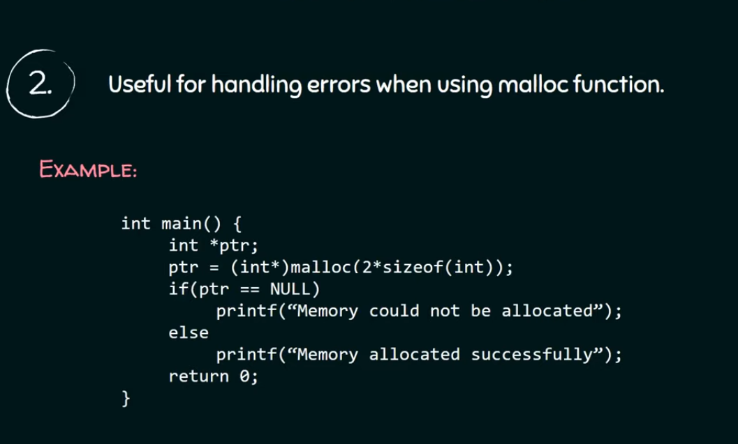
Use of Null Pointer

Slide 51
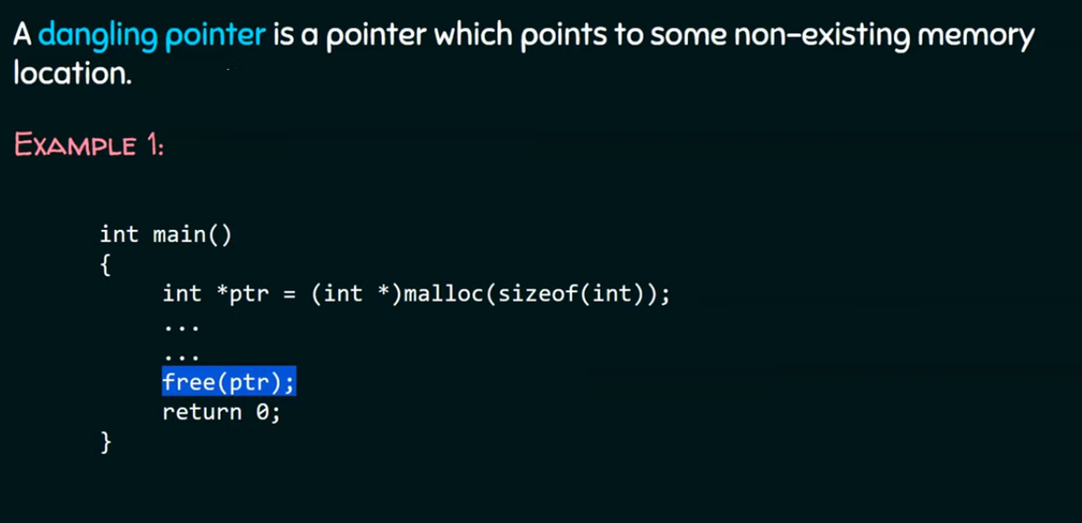
Dangling Pointer

Slide 52
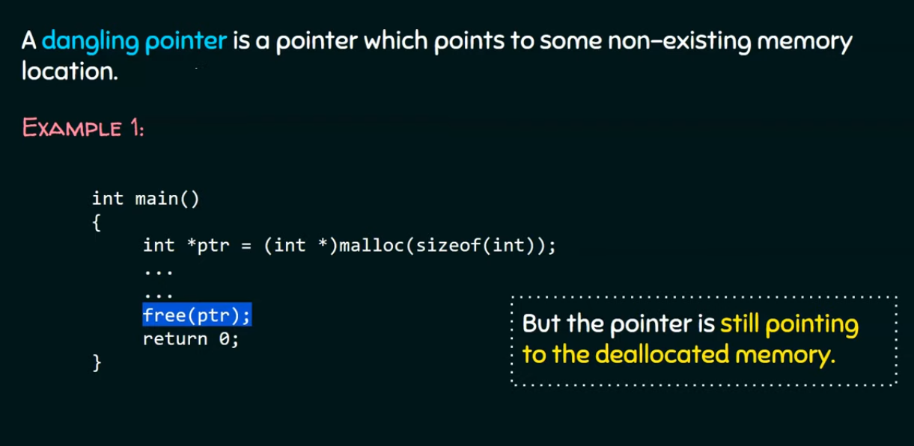
Dangling Pointer

Slide 53
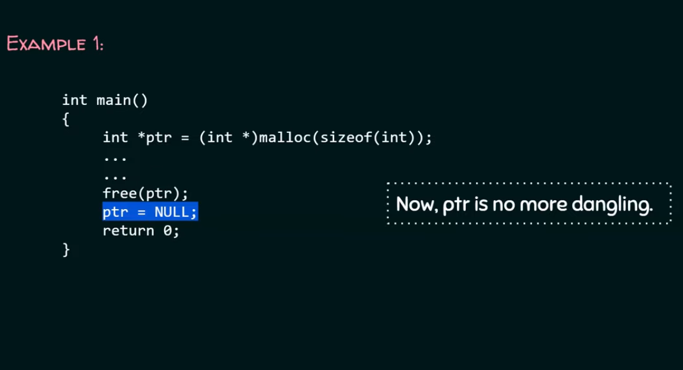
Dangling Pointer- solution

Slide 54
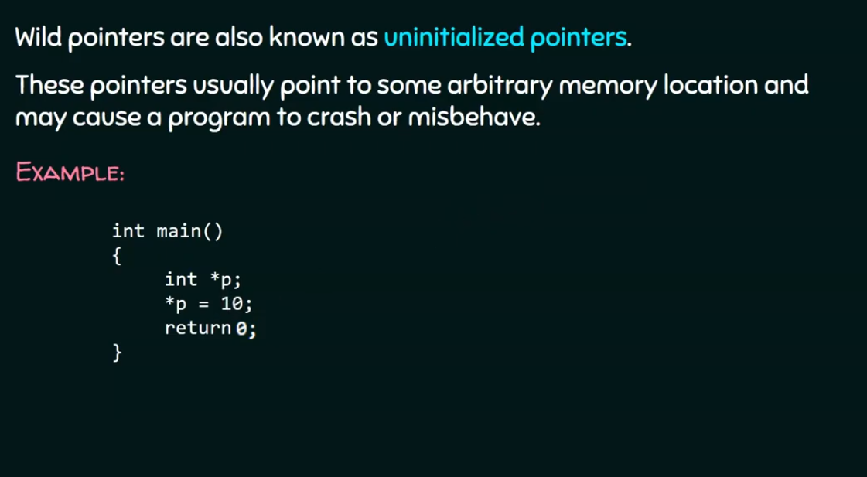
Wild Pointer

Slide 55
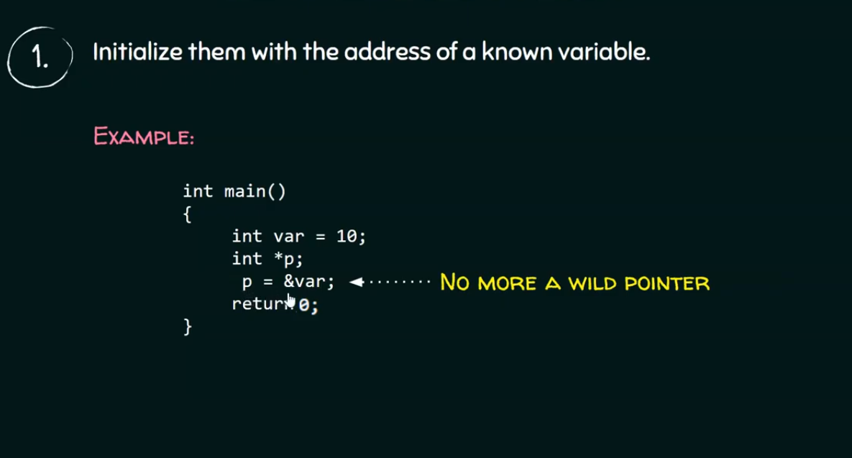
How to avoid Wild Pointer

Slide 56
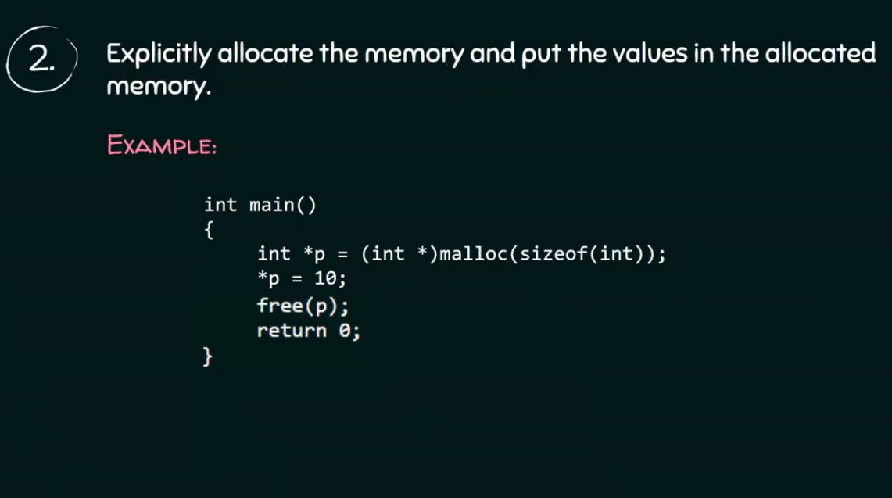
How to avoid Wild Pointer

Slide 57
Algorithm Complexity Analysis

Slide 58
What is an Algorithm ?
Step by step procedure to solve a problem is defined as ALGORITHM.
How algorithm is different than writing a program ?
We can compare algorithm to design and program to implementation phase of Software Development Life Cycle.
In algorithm we write in simple English like statements which are easy to understand (without bothering about syntax) whereas while writing a program we write language specific code (care is given to the syntax).

Slide 59
Characteristics of an Algorithm
Unambiguous -all steps must be clear
Input - Either 0 or more inputs
Output -Must have output
Finiteness − Algorithms must terminate after a finite number of steps.
Feasibility − Should be feasible with the available resources.
Independent-independent of any programming code

Slide 60
Why we need to calculate the performance of an algorithm?
Consider 2 programmers “A” and “B”. Both of them submits 2 different solutions for the same program. Now how do we decide which solution is efficient and performs better?
And also A’s program might perform better for small number of input but will not perform when the input size increases.
Similarly, B’s program will not perform when the input size is small but will perform better for large number of input.
Hence to determine which of the solution is better, we take a look at 2 important factors that decide the performance of an algorithm:
1. Space Complexity 2. Time complexity

Slide 61
Various complexities of algorithms
Constant: O(1)→ constant number of operations, not depending on the input data size,
e.g. n=10000→ 1 operation.
Logarithmic: O(log n)→ No. of operations proportional of log n where n is the size of input data,
e.g. n=1000→10operations.
Linear: O(n)→no. of operations proportional to the input data size,
e.g. n=10000→ 10000operations.
Quadratic: O(n²)→No. of operations proportional to the square of the size of the input data.
e.g. n=500→250000 operations
Cubic: O(n³)→ no. of operations proportional to the cube of the size of the input data,
e.g. n=10→ 1000 operations
Exponential: exponential no. of operations, fast growing,
e.g. n=20→ 1048576 operations.

Slide 62
Common time complexities
BETTER
WORSE
O(1) constant time
O(log n) log time
O(n) linear time
O(n log n) log linear time
O(n²) quadratic time
O(n³) cubic time
O(2^{n}) exponential time

Slide 63
Assume that we have a machine that can execute 1,000,000 required operations per sec
Table 1. Execution time for algorithms with the given time complexities
 | Algorithm 1 | Algorithm 2 | Algorithm 3 | Algorithm 4 | Algorithm 5
Frequency count | n | nlogn | n² | n³ | 2^{n}
n=10 n=10,000 | < 1 sec < 1 sec | < 1 sec 6 sec | < 1 sec 22 min | < 1 sec 39 days | < 1 sec many many centuries

Slide 64
Time and space
To analyze an algorithm means:
developing a formula for predicting how fast an algorithm is, based on the size of the input (time complexity), and/or
developing a formula for predicting how much memory an algorithm requires, based on the size of the input (space complexity)
Usually time is our biggest concern
Most algorithms require a fixed amount of space

Slide 65
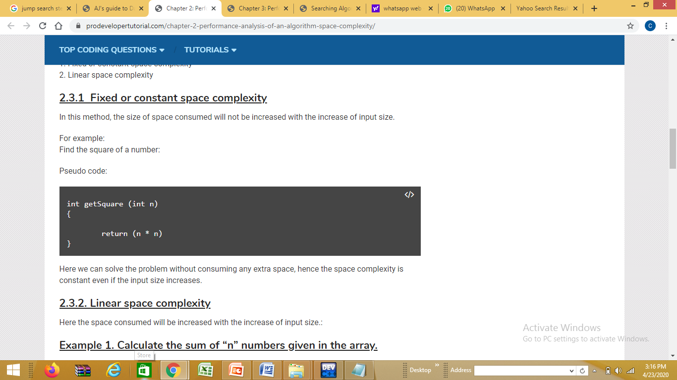
Space Complexity
Space complexity can be broadly classified into 2 types.
Fixed or constant space complexity
Linear space complexity
Fixed or constant space complexity example

Slide 66
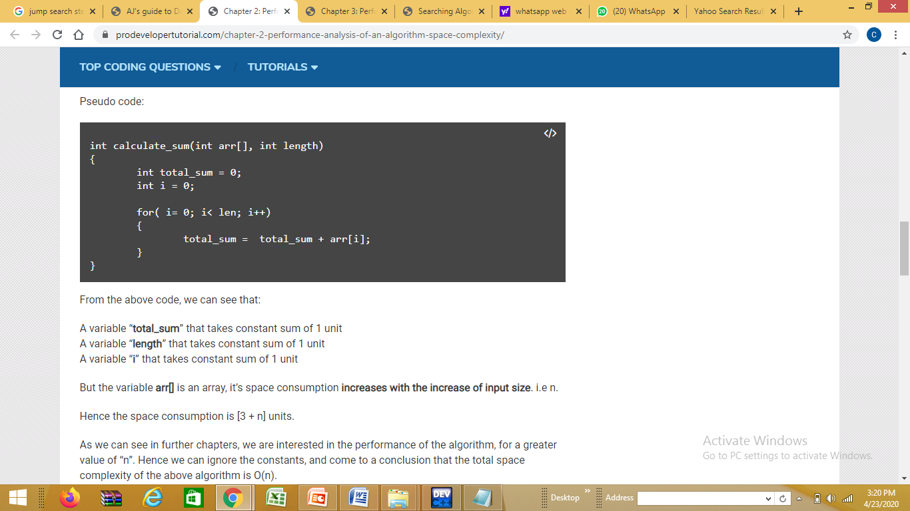
Space Complexity
Linear space complexity: Here the space consumed will be increased with the increase of input size
Calculate the sum of “n” numbers given in the array.

Slide 67
Time Complexity: Asymptotic Notations
Asymptotic Notations are mathematical functions that are used to calculate running time and also the rate of growth of an algorithm.
Types of Asymptotic Notations
Big O: We use this notation to calculate the worst case and is called as tight upper bound and can be used to describe the execution time required or the space used (e.g. in memory or on disk) by an algorithm.
Big Omega: We use this notation to calculate the lower bound.
Bit Theta: We use this notation to calculate the average case.
Let us understand Best, average and worst case with the help of an example:
Consider that we are searching for a key in list of 10 items. We search one by one, a linear search.
Here Best-case will be, the key present at the first item itself.
Average case is, the key present somewhere in the middle of the 10 items.
Worst case is the key present at the last item.

Slide 68

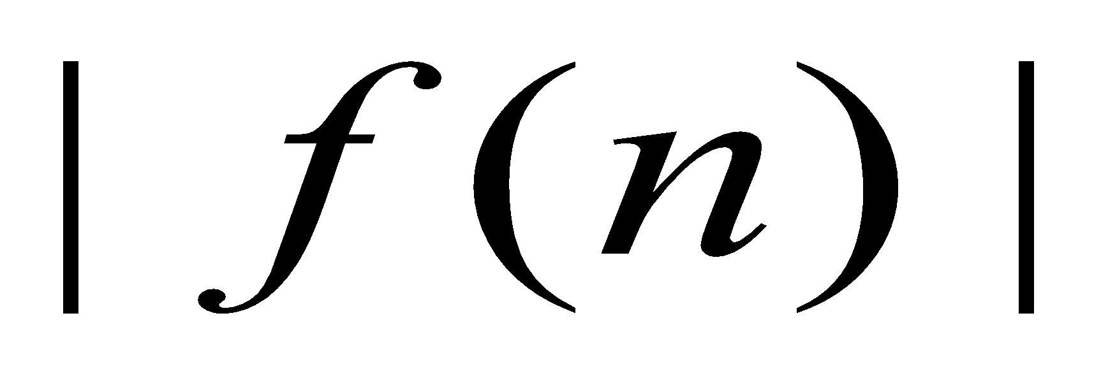
Big O notation
Def f(n) = O(g(n)) if and only if ∃ 2 positive constants c and n₀,
such that
|f(n)| ≤ c ∙ |g(n)| ∀ n ≥ n_{0.}
So, g(n) actually is the upper bound of f(n).
n₀
Figure 1. Illustrating “big O”

Slide 69
Examples:
Is
17 n² – 5 = O(n²)?
35 n3 + 100 = O(n3)?
And for what parameter values ?

Slide 70
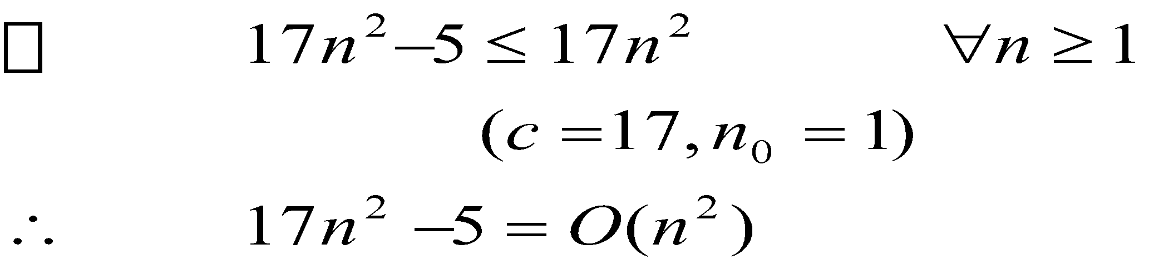
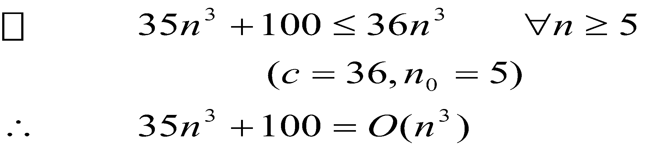
Examples:
17 n² – 5 = O(n²)?
35 n3 + 100 = O(n3)?

Slide 71
STEPS TO COMPUTE BIG O TIME COMPLEXITY
FOR A GIVEN EXPRESSION DO THE FOLLOWING :
DROP LOWER ORDER TERMS
DROP ALL CONSTANT MULTIPLIERS

Slide 72
Simplifying the formulae
Throwing out the constants is one of two things we do in analysis of algorithms
By throwing out constants, we simplify 12n² + 35 to just n²
Our timing formula is a polynomial, and may have terms of various orders (constant, linear, quadratic, cubic, etc.)
We usually discard all but the highest-order term
We simplify n² + 3n + 5 to just n²

Slide 73
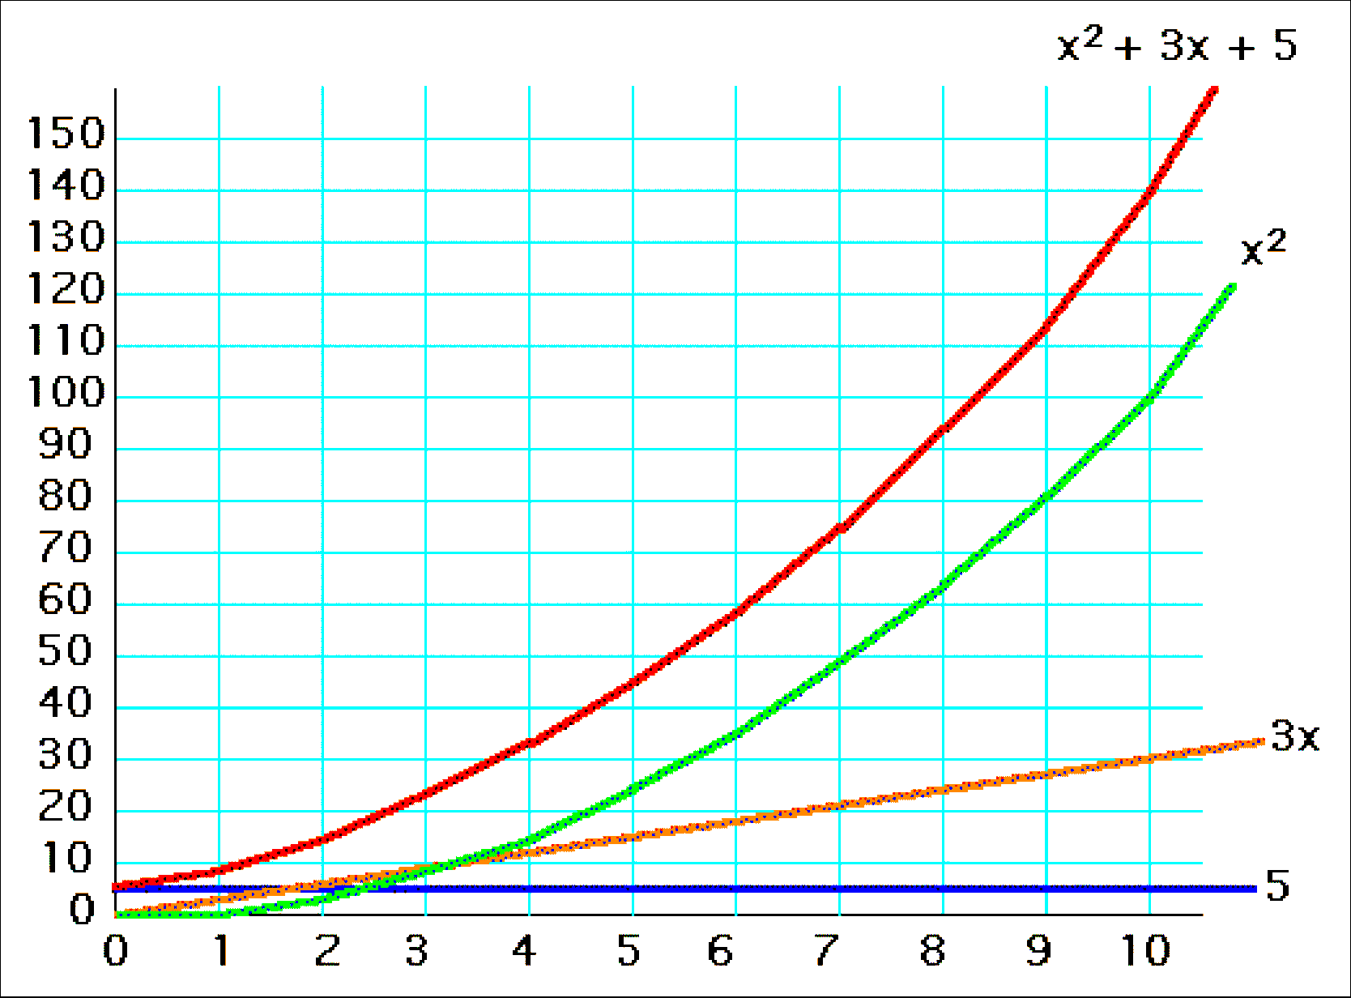
y = x² + 3x + 5, for x=1..10

Slide 74
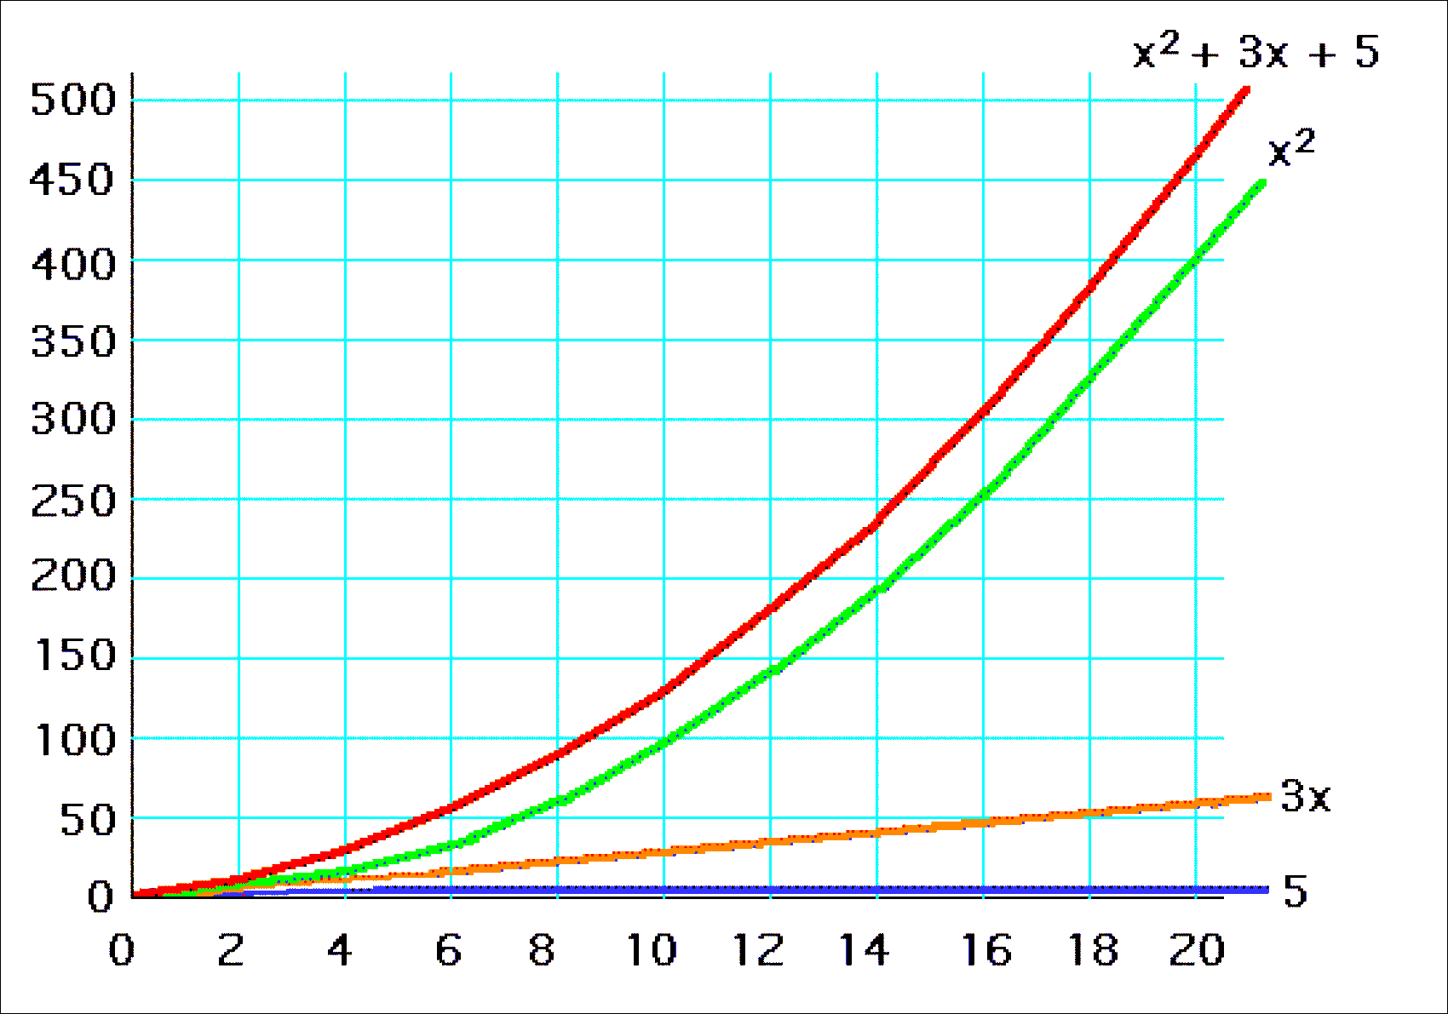
y = x² + 3x + 5, for x=1..20

Slide 75
LETS SEE THE TIME COMPLEXITY OF THE FOLLOWING CODES
SINGLE LOOP
for(i=0;i<n;i++)
{
x=a+b;
}

Slide 76
LETS SEE THE TIME COMPLEXITY OF THE FOLLOWING CODES
NESTED LOOP
for(i=0;i<n;i++)
{
for(j=0;j<m;j++)
{
x=a+b;
}
}

Slide 77
LETS SEE THE TIME COMPLEXITY OF THE FOLLOWING CODES
SEQUENTIAL STATEMENTS
a=b+c;
for(i=0;i<n;i++)
{
z=z+y;
}
for (j=0;j<n;j++)
{
a=a+b;
}

Slide 78
LETS SEE THE TIME COMPLEXITY OF THE FOLLOWING CODES
If –Else statements
if( condition1)
{
for(……i<n…..)
{
…
}}
else
{
for (……i<n…)
{for(….j<n….)
{………}}

Slide 79
References
Lipschutz, Seymour, “Data Structures”, Schaum's Outline Series, Tata McGraw Hill.
Goodrich, Michael T., Tamassia, Roberto, and Mount, David M., “Data Structures and Algorithms in C++”, Wiley Student Edition.
https://www.tutorialspoint.com/data_structures_algorithms/algorithms_basics.htm
https://www.cs.utexas.edu/users/djimenez/utsa/cs1723/lecture2.html

Slide 80
Books Recommended
Lipschutz, Seymour, “Data Structures”, Schaum's Outline Series, Tata McGraw Hill.
Gilberg/Forouzan,” Data Structure with C ,Cengage Learning.
Augenstein,Moshe J , Tanenbaum, Aaron M, “Data Structures using C and C++”, Prentice Hall of India

Slide 81
THANK YOU

